Slide 2
AGENDA
2025-26 School Year
College Costs
What?
How?
When
What?
Free Application Federal Student Aid (FAFSA)
NYS TAP Application
Others – depends on school
Strategies/Tools

Slide 3
What Is Cost of Attendance (COA)?
Tuition and fees
Housing and food
Books, course materials, and supplies
Transportation
Miscellaneous and personal

Slide 4
Average Cost of Attendance (COA)
Typical Costs by Type of College | Private College | SUNY Public | Community College
Tuition and Fees | $40,000 | $8,500 | $6,000
Living Expenses Housing and Food | $14,000 | $14,000 | ????
Books/Course Materials/Supplies | $1,500 | $1,500 | $1,500
Transportation | $1,000 | $1,000 | $2,000
Personal Expenses | $1,500 | $1,500 | $1,500
Total | $58,000 | $26,500 | $11,000

Slide 5
What Is Student Aid Index (SAI)From FAFSA Results
Measurement of family’s ability to pay for college
SAI is new terminology in first used in 24-25 year
The SAI replaced Expected Family Contribution (EFC) used in prior years

Slide 6
Student Aid Index (SAI)
Index number that the financial aid office uses to determine aid eligibility
Stays the same regardless of college choice
In some cases, students of highest need, could be negative number
Derived from FAFSA formula – including income, assets, and family size

Slide 7
What Is Financial Need?
Cost of attendance (COA) – Student Aid Index (SAI) – Other Financial Assistance (OFA) = Financial need

Slide 8
Financial Need Examples
Cost of Attendance | $40,000
- SAI | $15,000
= Need | $25,000
Cost of Attendance | $65,000
- SAI | $15,000
= Need | $50,000

Slide 9
Sources of Financial Aid
Federal – Pell Grant, SEOG Grant, Teach Grant, Work-Study, Student Loans, Parent Loans
State - New York Grant (TAP) for New York residents attending college in NY State, Excelsior.
College you attend – Scholarships, work, loans
Private/Outside Sources – Scholarships, loans, tax credits, Veterans Benefits

Slide 10
Types of Financial Aid
Scholarships
Grants
Loans
Work-Study Employment
Self-Help Aid
Gift Aid

Slide 11
GRANTS
FEDERAL
STATE
PELL Grant
Derived from FAFSA
Based on income and family size
$0 to $7395 (2024-25)
SEOG Grant
Determined at each school –highest need students – limited funds
TEACH Grant - limited number usually near end of college
TAP – any NY college
NY Net Taxable Income below $125,000
Excelsior – SUNY 2 year or 4 year college – Federal Income $125,000 or below

Slide 12
Scholarships
Your College
Review Website for merit, need, application
High School
Civic Groups or Businesses
Places of Employment
Free Internet Searches
Example:
www.fastweb.com
www.finaid.org

Slide 13
Federal Direct Student Loan
Subsidized – 6.53% Interest rate (in 2024-25).
Based on need (COA – SAI – other aid = Financial need)
Federal government pays interest while student in school
Freshman may borrow up to $3,500
Unsubsidized – 6.53% Interest rate (in 2024-25).
Not based on need
Student is responsible for interest while in school, can be deferred but will capitalize
Freshman may borrow up to $5,500 minus any subsidized loan money (ideally - $3,500 subsidized and $2,000 unsubsidized)
Repayment begins 6 months after graduation

Slide 14
Parent Loan for Undergraduate Students (PLUS)
Federal Loan in parent name
Credit Check – No Adverse Credit
9.08% interest rate (2024-25)
Interest accrues at disbursement
Payments right away or can be deferred but interest will accrue
Limits
Up to COA minus other aid.

Slide 15
Work Opportunities
Federal Work Study Program (FWS)
Need Based
Limited hours
Usually minimum wage
Helps with personal expenses
Each college has own process; jobs usually on campus or in community service.

Slide 16
HOW TO APPLY FOR FINANCIAL AID
Complete Federal Process – start at studentaid.gov
FAFSA
Complete NY STATE Process – start at hesc.ny.gov
TAP APPLICATION
Complete process and any requirements at each college – check their websites – talk with Admissions/Financial Aid Staff
Search Private Scholarships
Follow up – later applications, documents, communication

Slide 17
How to Apply for Federal Financial Aid
Go to studentaid.gov for complete information on federal financial aid programs and applying
Create a StudentAid.gov account (sometimes called Federal Student Aid ID – or FSA ID) for the student and parent of record (Anytime Now) – takes up to 3 days to authenticate.
Remember/Save your StudentAid.gov account information
Complete FAFSA online: it opens December 1, 2024 for the 2025-26 year
Reapply every school year

Slide 18
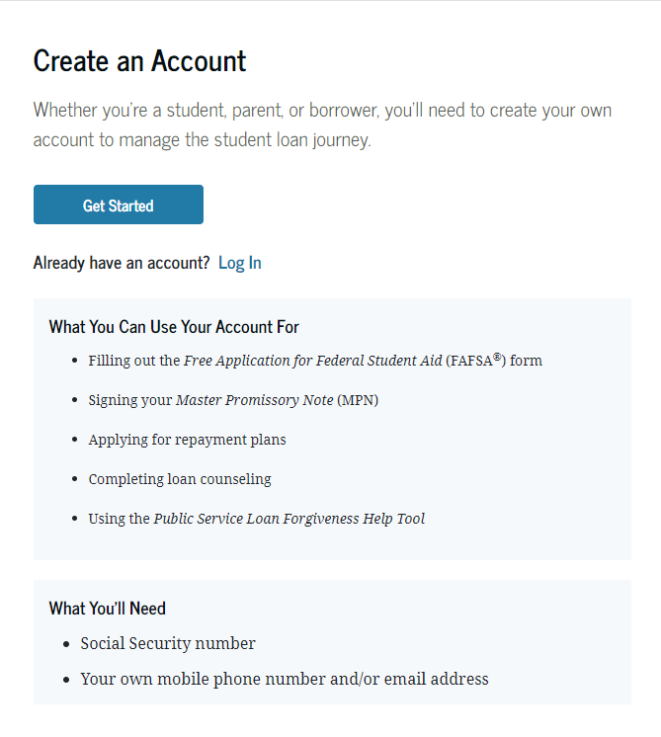
Account Username and Password (FSA ID)
Used for FAFSA completion and access to certain U.S. Department of Education websites
Student and parent must create their own FSA ID
May be used throughout financial aid process, including subsequent school years
Only the owner should create an FSA ID
Apply at https://studentaid.gov/fsa-id/create-account/launch

Slide 19
FAFSA https://studentaid.gov/h/apply-for-aid/fafsa

Slide 20
FAFSA for 25-26
Redesigned and simplified in 24-25 year and going forward.
Student begins FAFSA after signing in with their StudentAid.gov account.
After completing their part – they invite parent(s) via email in the form – to be contributor on the FAFSA. Student will need parent SSN to complete this process.
Parent receives email and signs in with their FSA ID and completes their part and submits form
Student and Parent, when on the FAFSA, will have to consent for Direct Data Exchange with IRS for Federal Tax Information to load into FAFSA.
Sometimes, both Parents will need to be contributors if they are married and file separate taxes. This would mean both parents need their own StudentAid.gov account
For Separations and Divorces – the parent of record whose information would go on FAFSA is the parent who provided the most financial support over the last 12 months; if that parent remarried, step parent information needs to be included.

Slide 21
FAFSA for 25-26
Income – Taken directly from IRS Direct Data Exchange – 2023 income
Adjusted Gross Income
Deductible payments to SEP/SIMPLE/KEOGH/Other
Untaxed portions of IRA distributions and Pensions (excluding rollovers)
Family Size
IRS definition of Tax Dependents
Family will be able to answer additional questions if family size different than dependents on tax returns
Assets
Cash, savings, checking, money market funds
Net worth of investments, including real estate (excluding primary residence)
Adjusted Net Worth of Business and/or Farm
Annual Child Support Received
NOT retirement funds

Slide 22
How To Apply State Aid
Complete TAP Online
https://www.hesc.ny.gov
After completing FAFSA
Can click on link after submitting Fafsa or wait until FAFSA processed and sign into HESC directly
Establish student HESC PIN.
Student and Parent e-sign at end of application.
Must re-apply each academic year.

Slide 23
Apply for Excelsior (when available) If SUNY College or Community College in NY
To be notified when (if) the application becomes available
Sign up for the HESC alert at www.hesc.ny.gov/excelsior
Same website as TAP
Application will not be available until some time in 2025 – usually April

Slide 24
Excelsior Scholarship
How it works:
Award equals max of SUNY Tuition minus any amounts received for TAP, Pell or other scholarships
Earn 30 Credits Per Year
Live and work in NY after college
$125,00 is the income limit in 2024-25

Slide 25
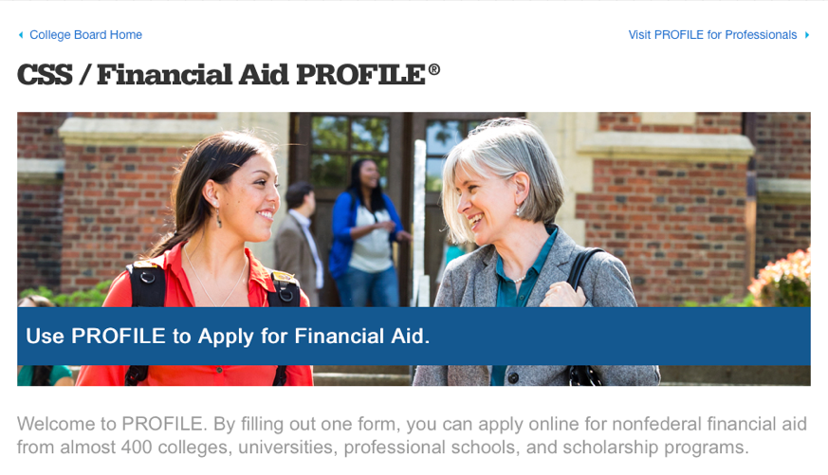
CSS/ Financial Aid PROFILE
(For Some Competitive Private Colleges)
The PROFILE is a form that allows students to complete one form and apply online for non-federal financial aid from almost 400 colleges, universities, professional schools, and scholarship programs. Check with college – usually just highly competitive private colleges.
https://cssprofile.collegeboard.org

Slide 26
Review 2025-26 Timeline
StudentAid.gov Account (FSA ID)– Now or Near Future
Scholarship Searches – Now/Ongoing
FAFSA – December 1, 2024 or later
TAP – After FAFSA.
Other Forms??
Excelsior for SUNY; CSS Profile some privates
Some schools may have separate form for their own scholarships, etc…

Slide 27
Watch for Results & Communicate with Financial Aid Office
FAFSA Results will be available in 3-5 days – to student and colleges (list up to 20 on the FAFSA)
Schools May Ask for Follow up Forms or Documents – To Verify Reported Information.
Each Schools timing will vary.
Eventually Receive Financial Aid Offer Letters from Accepted Schools in Spring 2025.

Slide 28
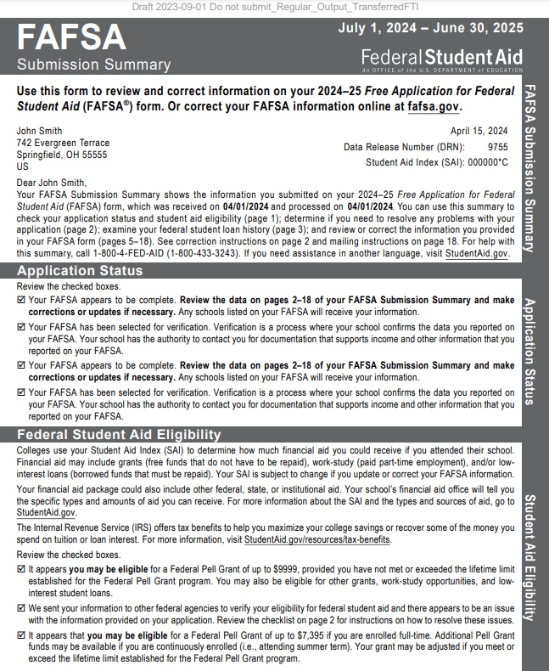
FAFSA Submission Summary

Slide 29
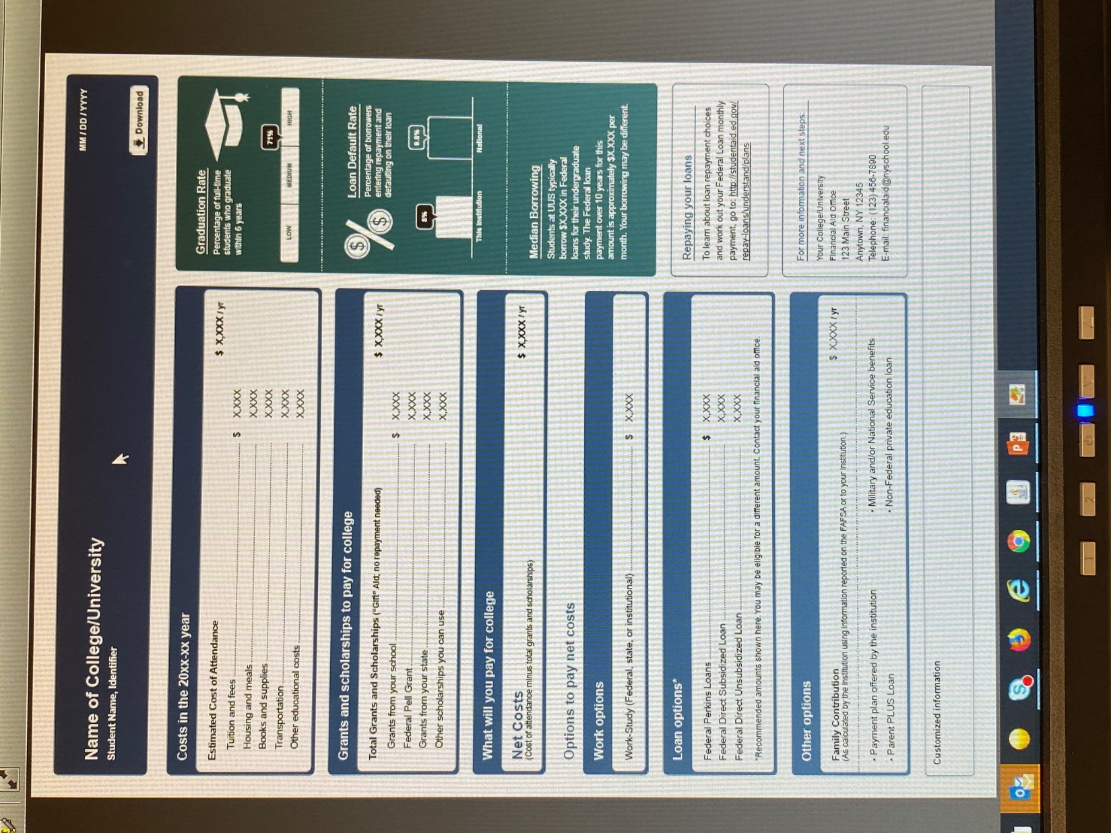

Slide 30
Strategies - Preparation
Keep Organized – be ready to follow up
remember FSA ID; folder for documents; etc…
Meet Deadlines!
Be Patient – Accuracy is Crucial
Parent/Student Communication
E-mail checking
FERPA- Student has to grant access for parent to interact with school
Compare – Make Charts?
Required forms and dates for each school
Payment Plan as opposed to Alternative Financing or Parent Loan.
Savings – 529 plans
Reduce costs when you can– books, tech, etc…

Slide 31
Special or Unusual Circumstances
Conditions exist that cannot be documented with the FAFSA
Send explanation and documentation to your college’s financial aid office after initial FAFSA results are done
College will review and request additional information if necessary
Decisions are final and cannot be appealed to U.S. Department of Education

Slide 32
Special or Unusual Circumstances
Unusual uncovered medical/dental expenses
Other Family Member in College
One time Payment Received
Death of Parent or Spouse
Student cannot get parental information
Divorce/Separation
Loss of employment or income

Slide 33
Questions
Jerome St. Croix, Director, Financial Aid
Monroe Community College
jstcroix@monroecc.edu

